Slide 1


2026-02-10
OKSANA ZIMINSKAJA

Slide 2
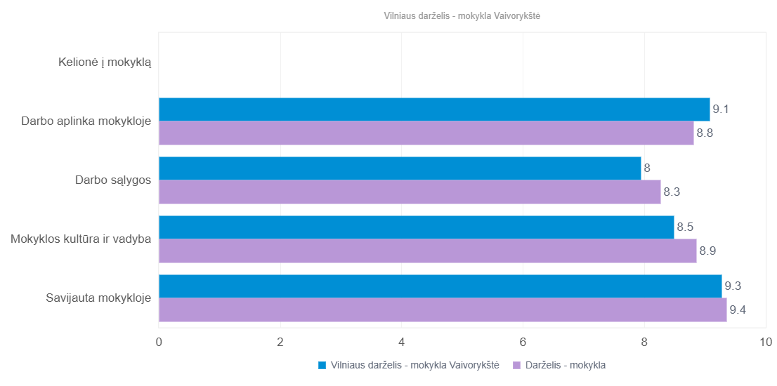

Chart Image 1
(Customer_msbar_Scores_SUMAVG-Group_vlnSvietPedag-Export-1770703784.png)
2

Slide 3
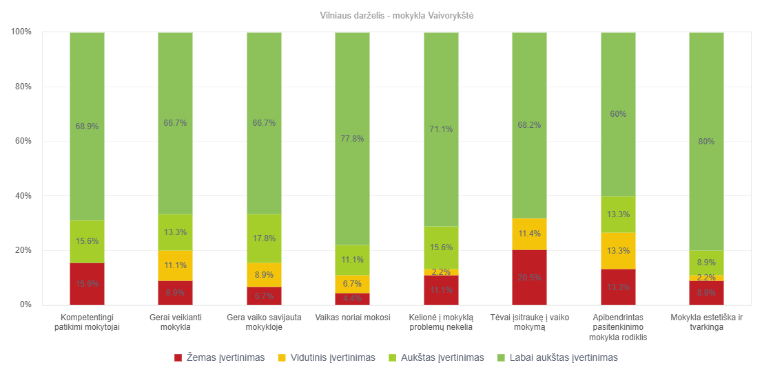
Chart Image 3
(Customer_Scores_SUMAVG_Bars_vlnSvietTev-Export-1770703784.png)
4

Slide 4
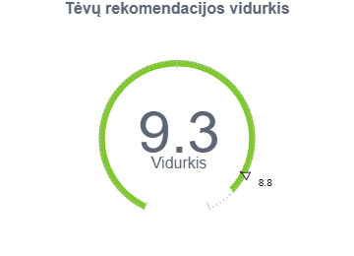
Chart Image 4
(Main_Score_Gauge_NPSA_vlnSvietTev_exp-1770703784.png)
5

Slide 5
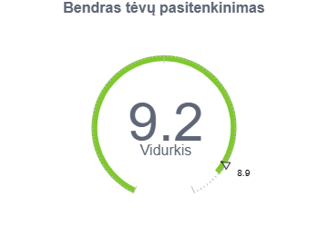
Chart Image 5
(Main_Score_Gauge_K5_vlnSvietTev_exp-1770703784.png)
6

Slide 6
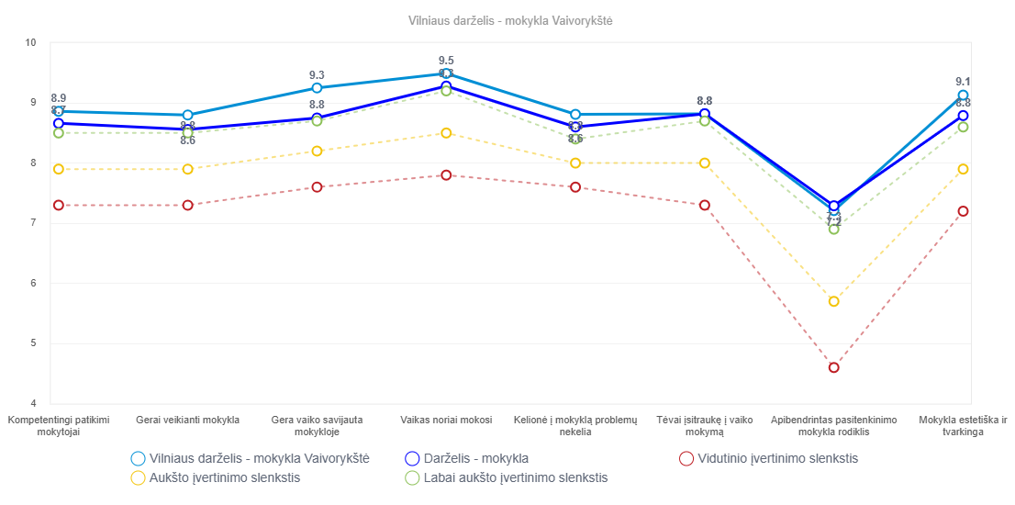
Chart Image 6
(Customer_Scores_SUMAVG_vlnSvietTev-Export-1770703784.png)
7

Slide 7
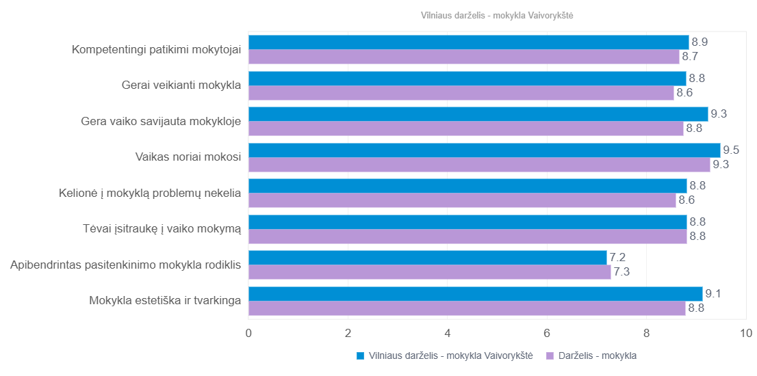
Chart Image 7
(Customer_msbar_Scores_SUMAVG_vlnSvietTev-Export-1770703784.png)
8

Slide 8
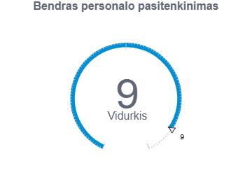
Chart Image 8
(Main_Score_Gauge_K2_vlnSvietPedag_exp-1770703784.png)
9

Slide 9
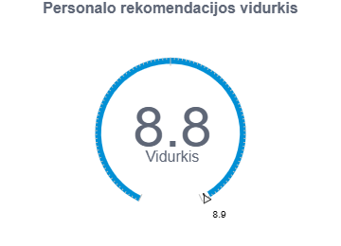
Chart Image 10
(Main_Score_Gauge_NPSA_vlnSvietPedag_exp-1770703784.png)
11

